Slide 1
What’s a taxonomy?
A classification
An organisation of things frequently in a hierarchical structure

Slide 2
Bloom’s taxonomy of educational objectives for the Cognitive Domain
There exist others of the affective Domain and the Psychomotor Domain:
Krathwohl, Bloom, & Masia (1964) created a taxonomy of educational objectives for the affective domain.
Elizabeth Simpson (1972) created a taxonomy for the Psychomotor Domain.

Slide 3
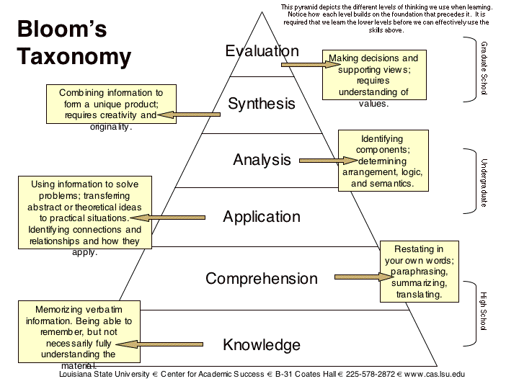

Slide 4
Bloom’s Taxonomy
Knowledge - Remembering previously learned information such as facts, terms, procedures and principles.
Comprehension – Grasping the meaning of information by putting it into one’s own words, drawing conclusions, or stating implications.
Application – Applying knowledge to actual situations as in taking principles learned in Math and applying them in physics experiment or applying principles of civil liberties to current events.
Analysis – Breaking down objects or ideas into simpler parts and seeing how the parts relate and are organized. For example, discussing how the public and the private sector differ or detecting logical fallacies in an argument.
Synthesis – rearranging component ideas into a new whole. For example, planning a panel discussion or writing a comprehensive paper/thesis.
Evaluation – Making judgements based on internal evidence or external criteria. For example, evaluating a work of art, editing a paper, or deciding/ making a professional call on how long a scheme of work should be!

Slide 5
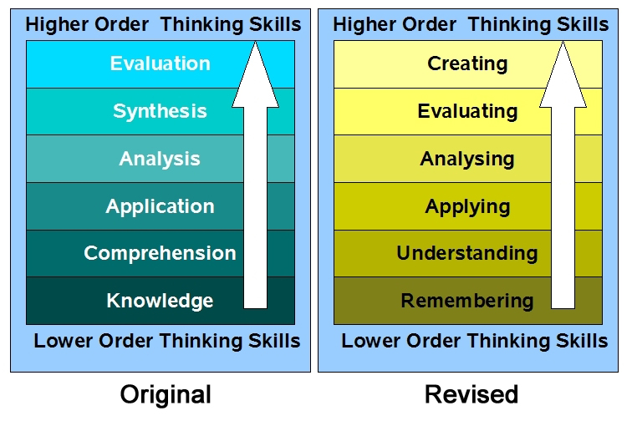
Bloom’s Taxonomy

